Slide 1
Django Forms
Md. Nahiyan Uddin

Slide 2
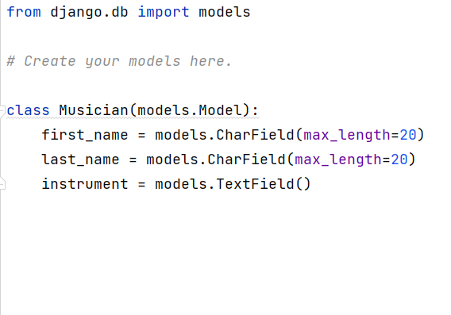
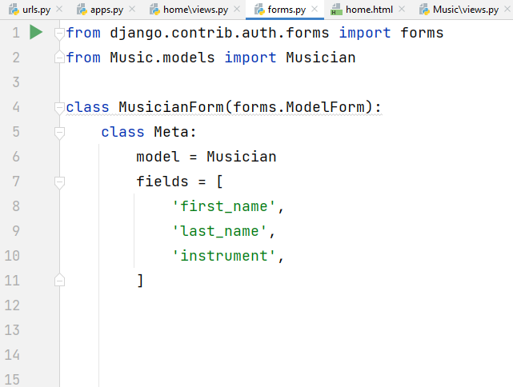
Creating Model Forms

Slide 3
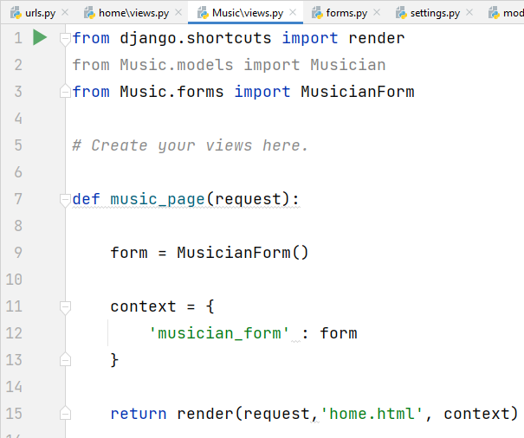
Passing the form through template

Slide 4
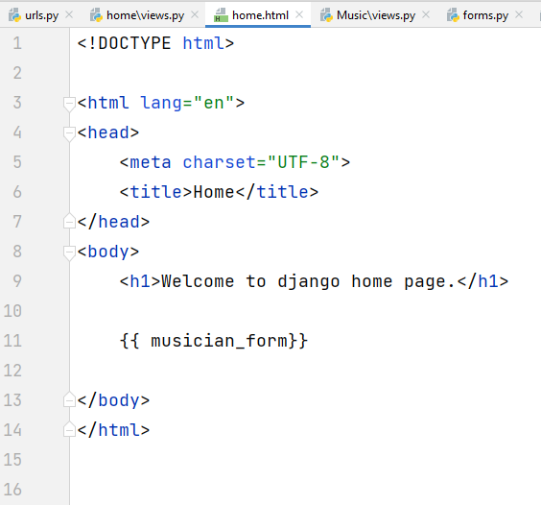
Showing the form in the HTML

Slide 5
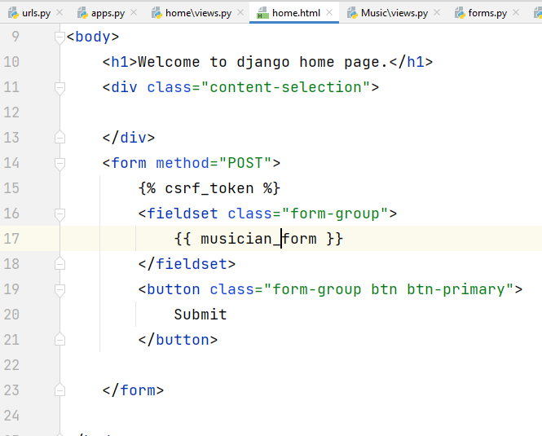
Adding the form tags and submit button

Slide 6
Adding the django-crispy-forms
install django-crispy-forms in your Django project-
$ pip install django-crispy-forms
add crispy_forms to the list of installed apps in the settings
add the crispy_template_pack to the settings.py file
CRISPY_TEMPLATE_PACK = 'bootstrap4'
load in the Django crispy_forms_tags in the HTML template
add the |crispy or |as_crispy_field filter to the Django form variable

